Slide 1
Prosecuting Cases Post Crawford v. Washington

Slide 2
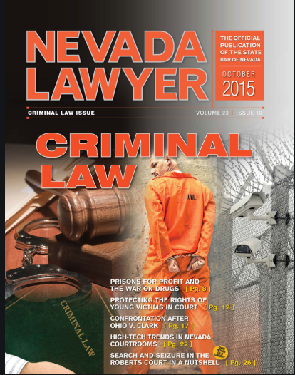
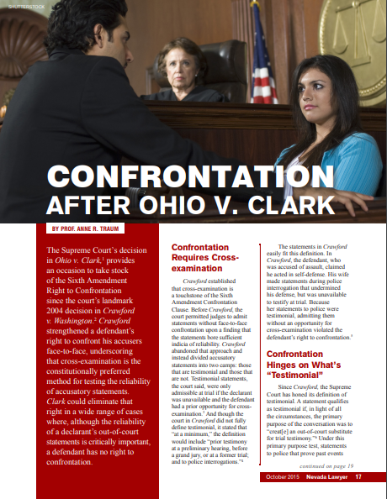

Slide 3
What has fallen out of view is the value of cross-examination; whether it would assist the factfinder in assessing the credibility of a declarant whose accusations are critical to guilt or whose reliability is already at issue. Crawford railed against the courts usurping the factfinder’s role in assessing the reliability of accusatory statements. Clark shows that the court’s narrow definition of “testimonial” may lead to even less confrontation, cross-examination and adversarial testing than before Crawford.

Slide 5
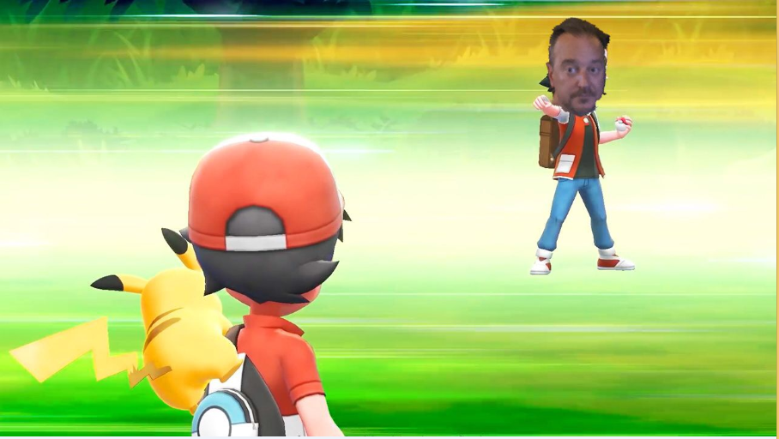
Prepared for battle

Slide 6
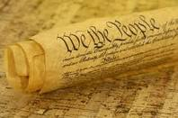
Confrontation Clause
Sixth Amendment -
"in all criminal prosecutions, the accused shall enjoy the right...to be confronted with the witnesses against him.”
Goal – ensure reliability of the evidence, statements, or testimony.

Slide 7
Our troubles begin with Ohio v. Roberts,448 U.S. 56 (1980)
Out-of-court statements can be admissible if they bear an adequate “indicia of reliability,” even if the declarant is not available to testify in court.
They found that one could infer reliability in cases where the evidences falls “within a firmly rooted hearsay exception,” but even in other cases, if “particularized guarantees of trustworthiness” can be shown, the evidence would be admitted.

Slide 8
2004 Crawford v. Washington
Facts:
Crawford charged with stabbing man.
Claimed self-defense.
Crawford’s wife gave a taped statement to police
Wife invoked spousal privilege at trial (making her “unavailable”)

Slide 9
Crawford v. Washington
At trial, State played the taped statement of Crawford’s wife given to police.
Descriptions of what she witnessed during the stabbing.
Appropriate hearsay exceptions utilized:
Statements against penal interest (because she inculpated herself)
Wife never took the stand so she was never subject to cross examination

Slide 10
Crawford v. Washington Holding
Out-of-court statement by a witness that is testimonial in nature is barred by Confrontation Clause of the 6th Amendment (testimonial hearsay).
Exception: witness is unavailable and was previously subject to cross examination
Why? Only way to establish a sufficient reliability of a statement to satisfy constitutional demands is confrontation.
Deviates from “indicia of reliability” test
i.e. Ohio v. Roberts

Slide 11
Crawford deals with hearsay exceptions
No Crawford issue, evidence comes in if otherwise admissible.
Is the Evidence Hearsay?
NO
Statement okay if not offered for proving the truth of the matter asserted.
NRS 51.035 Defines Hearsay
Non-hearsay – doesn’t apply

Slide 12
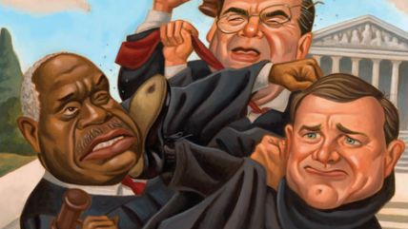
-vs-
Crawford v. Washington
(new)
Ohio v. Roberts
(old)
Out-of-court statement by a witness that is testimonial in nature is barred by Confrontation Clause of the 6th Amendment (testimonial hearsay)
Hearsay evidence admissible if the evidence bears an adequate indicia of reliability

Slide 13
Nevada has a Roberts statute
NRS 51.315 General exception; other exceptions illustrative.
1. A statement is not excluded by the hearsay rule if:
(a) Its nature and the special circumstances under which it was made offer strong assurances of accuracy; and
(b) The declarant is unavailable as a witness.

Slide 14
Limitations with NRS 51.315
Scenario:
Defendant accused of killing five-year old victim. Only eyewitness to killing is defendant’s own five-year old daughter.
Daughter tells CPS investigator, a police investigator, and her foster mother what happened.
Daughter is unavailable to testify at trial so CPS investigator, Metro abuse investigator, and foster mom testified to the 5-year old’s statements.
Who can testify about the daughter’s statements?

Slide 15
Flores v. State, 121 Nev. 706 (2005) addressed NRS 51.315 post Crawford
Victim never testified because too distraught. DC allowed statements to be played at trial. Court found strong assurances of accuracy because statement corroborated by medical evidence.
Statements to CPS investigator and Metro abuse investigator are testimonial
because reasonable person would believe the statement would be used at trial. Therefore, their statements are inadmissible.
However, statements to foster mother are admissible because spontaneously made.

Slide 16
Flores v. State, 121 Nev. 706 (2005)
First Nevada case addressing Crawford.
Addressed what “testimonial” means.
Testimonial: “Statements that, under the circumstances of their making “would lead an objective witness reasonably to believe that the statement would be available for use at a later trial.” (Quoting Crawford)
A casual remark to an acquaintance is not the same as a formal statement to officers.

Slide 17
Testimonial?
NO
No Crawford issue, evidence comes in if otherwise admissible.
Is the Evidence Testimonial?
Not specifically defined in Crawford, but has been explained in subsequent cases
Court did say testimonial statements include “statements that were made under circumstances that would lead an objective witness reasonably to believe that the statement would be available for use at a later trial”

Slide 18
Following Crawford, the Court needed to clarify what is testimonial and nontestimonial evidence
Hammon v. Indiana
Davis v. Washington
Testimonial
Nontestimonial
Melendez-Diaz v. Massachusetts
Michigan v. Bryant
Bullcoming v. New Mexico
Ohio v. Clark
Williams v. Illinois

Slide 19
Hammon Facts
Davis Facts
Police respond to domestic disturbance
See victim outside, she appeared frightened but said there was nothing wrong
Victim eventually wrote out a voluntary statement implicating the defendant
Victim ignored subpoena
Police respond to a 911 call where victim is stating that suspect is hitting her again
Police respond and victim is visibly shaken and has some injuries
Victim does not respond to the subpoena
911 call is played at trial

Slide 20
Davis v. Washington, 547 U.S. 813 (2006) (Defining testimonial v. nontestimonial)
Statements are nontestimonial when made in course of police interrogation under circumstances objectively indicating that the primary purpose is to enable police assistance to meet an ongoing emergency (the Davis facts)

Slide 21
Davis v. Washington (cont.)
Statements are testimonial when circumstances objectively indicate that there is no ongoing emergency and that the primary purpose of the interrogation is to establish or prove past events potentially relevant to later criminal prosecution (the Hammon facts)

Slide 22
The power of 911 calls
Defendant stabbed his wife to death in front of his 10 year- old daughter and 12 year-old son.
The defendant had been arrested for Battery Domestic Violence just 5 months before. The 10 year old daughter had called 9-11 after she witnessed her father push her mother against a wall. The defendant was not convicted of that crime, as the District Attorney’s office did not approve the case for prosecution.
On April 8, 1998, The defendant stabbed Trevia Tucker almost 40 times with a butcher knife. She bled to death as a result of the stab wounds. The defendant stabbed her to death as she called 911 for assistance during a battery domestic violence incident.

Slide 24
Admissibility of 911 calls
Primary purpose of 911 call usually not to establish past event
Facts as they are happening
Help an ongoing emergency
Including identifying information about the suspect
Compare
(present)
with
(past)

Slide 25
Post Davis Scenario
Facts: Victim is shot and police arrive shortly thereafter. Victim appeared in great pain. Police asked victim what had happened, who shot him, and where the shooting occurred. Victim replied that “Rick” shot him around 3 a.m. at Rick’s house. Victim was then transported to the hospital and dies soon thereafter.
What is the hearsay exception to get in victim’s statement?
Dying declaration

Slide 26
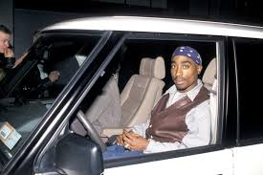
Michigan v. Bryant, 131 S. Ct. 1143 (2011)
Dying declaration made in the course of an ongoing emergency is non-testimonial (and thus admissible)

Slide 27
Bryant holding
Reaffirms “Primary purpose” test used from Davis v. Washington (note: primary purpose can vary depending on the crime)
Objective evaluation of the circumstances is used to determine the primary purpose
Existence of an ongoing emergency is among the most important factors to consider, but not the only factor
Statements and actions of both the declarant and the interrogators provide objective evidence of the primary purpose of the interrogation

Slide 28
Factual scenario
Preschool teachers notice that a 3-year old student has several bruise marks and they suspect that the child is being abused. Teachers ask the child if he is being hurt by anyone. After denying that he was hit, the child then tells his teachers that his step-dad hits him. In the trial against the step-dad defendant, the 3-year old is unavailable and does not testify.
Can the State prove its case by only using the teachers to testify what the 3-year old told them?

Slide 29
Ohio v. Clark – 135 S.Ct. 2173 (2015)
Statements by 3 year-old victim to preschool teachers who suspected abuse was not testimonial
The “primary purpose” was to determine victim’s safety – it was not contemplated that victim’s statements would be later used for prosecution purposes
Mandatory reporting obligations do not make a conversation between a student and concerned teacher testimonial

Slide 30
Two Nevada Statutes dealing with child hearsay
NRS 171.196(6)
NRS 51.385

Slide 31
NRS 171.196 (6)
Hearsay evidence consisting of a statement made by the alleged victim of the offense is admissible at a preliminary examination conducted pursuant to this section only if the defendant is charged with one or more of the following offenses:
(a) A sexual offense committed against a child who is under the age of 16 years if the offense is punishable as a felony. As used in this paragraph, “sexual offense” has the meaning ascribed to it in NRS 179D.097.
(b) Abuse of a child pursuant to NRS 200.508 if the offense is committed against a child who is under the age of 16 years and the offense is punishable as a felony.
(c) An act which constitutes domestic violence pursuant to NRS 33.018, which is punishable as a felony and which resulted in substantial bodily harm to the alleged victim.

Slide 32
NRS 171.196 (6) doesn’t violate Crawford
Sheriff v. Witzenburg, 122 Nev. 1056
Confrontation clause not applicable to preliminary hearings
Here, State used out-of-state affidavit pursuant to 171.197. Court specifically states Crawford doesn’t apply to NRS 171.196(5) (right to cross-examine at PH) or 171.197 (affidavit)

Slide 33
NRS 51.385 - Statement of Child Describing Sexual Conduct or Physical Abuse
A statement made by a child under the age of 10 years describing any act of sexual conduct performed with or on the child or any act of physical abuse of the child is admissible in a criminal proceeding regarding that act of sexual conduct or physical abuse if:
(a) The court finds, in a hearing out of the presence of the jury, that the time, content and circumstances of the statement provide sufficient circumstantial guarantees of trustworthiness; and
(b) The child testifies at the proceeding or is unavailable or unable to testify.
2. In determining the trustworthiness of a statement, the court shall consider, without limitation, whether:
(a) The statement was spontaneous;
(b) The child was subjected to repetitive questioning;
(c) The child had a motive to fabricate;
(d) The child used terminology unexpected of a child of similar age; and
(e) The child was in a stable mental state.
3. If the child is unavailable or unable to testify, written notice must be given to the defendant at least 10 days before the trial of the prosecution’s intention to offer the statement in evidence.

Slide 34
What if these were your child witnesses?

Slide 35
Factual scenario
Child discloses sexual abuse to her mother and father after being asked about it
Child told her mother, father, and a detective about the abuse
At a pretrial hearing, court ruled under NRS 51.385 that all statements given to the individuals above would be admissible
Can we protect the child from having to testify in court?

Slide 36
Pantano v. State – 122 Nev. 782 (2006)
NRS 51.385 is not facially unconstitutional
If a competent child witness takes the stand, then prior hearsay statements are admissible even if the statements are testimonial
If child’s hearsay statement is not testimonial, a district court may exercise its discretion to admit the statement, even if the child doesn’t testify
This principle is later affirmed by US Supreme Court in Ohio v. Clark

Slide 37
Confrontation met so long as Beavis takes the stand.

Slide 38
State of Crawford in Nevada 911 calls and Dying Declaration
Scenario: Victim is shot and runs to his neighbors house. Neighbor calls 911. Dispatcher tells neighbor how to care for victim but asks neighbor if victim knows who shot him. Neighbor asked victim. Victim tells neighbor “Jerry shot me and he was paid to do it.” Victim dies.
Is victim’s statement admissible?
Is 911 call admissible?
Yes, under Harkins v. State.

Slide 39
Harkins v. State, 122 Nev. 974 (2006)
Dying declaration is an exception to the Confrontation Clause. (note this decision predates Michigan v. Bryant where the US Supreme Court held that dying declaration is nontestimonial)
911 calls made in the course of an emergency are not testimonial.

Slide 40
State of Crawford in Nevada
Scenario: Defendant charged with sexually assaulting victim. Victim died before trial and never subjected to cross examination. Victim’s neighbor testifies at trial. Neighbor says that the day after the rape, she went to victim’s house and victim answered the door wearing only a bra and blood-soaked underpants. Victim immediately says “Look at me. Look at me. I’ve been raped.” Victim undergoes SANE exam. SANE nurse also testifies at trial about what the victim told her.
1.) Can the neighbor testify to the victim’s statements?
2.) Can the SANE nurse testify to the victim’s statements?

Slide 41
Medina v. State, 122 Nev. 346 (2006)
Neighbor’s testimony (admissible):
Victim’s statement falls under the excited utterance hearsay exception
Statement is nontestimonial and thus admissible
SANE nurse’s testimony (inadmissible):
Victim’s statements to SANE nurse are testimonial because duty of SANE nurse is to collect evidence for criminal prosecution

Slide 42
Greco v. State, 2016 WL 937117 (NV Appellate Court)
No confrontation issues with custodian of records of an insurance company reading notes kept between the insurance carrier and the accused - Not testimonial.
Evidence came in under business records exception.

Slide 43
Confrontation of Analysts

Slide 44
Factual scenario
Drug prosecution
Chemist was unavailable
State used chemist’s affidavit at trial to prove evidence impounded was in fact Cocaine
Defendant argued Confrontation Clause violation because he never had chance to cross-examine the chemist

Slide 45
Can we use chemist affidavit at trial to establish that evidence was cocaine?

Slide 46
Melendez-Diaz v. Massachusetts, 129 S.Ct. 2527 (2009)
Affidavits are testimonial
Point of affidavit in this case was to establish evidence for use at trial

Slide 47
Melendez Diaz also addresses business records
First, Court states that forensic affidavits are not business records
Second, Court recognizes business records hearsay exception, but not if the regularly conducted business activity is the production of evidence for use at trial
Again, Court is interested in the purpose the record was generated (compare: a certified copy of a lease versus an affidavit by a custodian that a defendant was never an employee)

Slide 48
Notable footnote in Melendez-Diaz
FN1 – Contrary to the dissent’s suggestion, we do not hold (emphasis added) that anyone whose testimony may be relevant in establishing the chain of custody, authenticity of the sample, or accuracy of the testing device must appear in person as part of the prosecution’s case.
Additionally, documents prepared in the regular course of equipment maintenance may well qualify as nontestimonial records

Slide 49
What about DUI cases?

Slide 50
Factual scenario
Defendant on trial for DUI resulting in harm
The forensic analyst did not testify because he was on unpaid administrative leave.
Trial court allowed prosecution to introduce forensic lab report containing defendant’s blood alcohol concentration by calling a separate forensic analyst on grounds this was a business record. The separate forensic analyst had no independent opinion concerning the report.

Slide 51
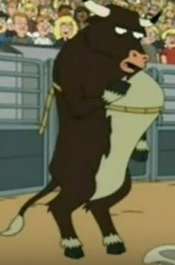
Bullcoming v. New Mexico, 131 S. Ct. 2705 (2011)
Forensic laboratory report is testimonial
Confrontation Clause does not allow for admission of the testimonial forensic report because it contains statements created for the purposes of prosecution

Slide 52
Factual scenario following Bullcoming
Victim sexually assaulted by a stranger
Vaginal swab from victim was sent to a private lab to develop an unknown DNA profile.
Illinois police lab compared the developed DNA profile from the private lab and compared it to its own database. The profile matched the Defendant.
The Illinois examiner testified that the profiles matched.
Can the Illinois examiner testify about the findings of the private lab?

Slide 53
Victim Sexually Assaulted
Biologist A confirms that sample has semen
Sample kept in a freezer
S.A. exam
Seals sample
Suspect arrested on unrelated charge
Forensic Scientist K extracted DNA profile
Suspect DNA in crime database
DNA taken
Input
Victim’s sample tested for DNA by independent lab
Crime lab given results and input into crime database
DNA found on victim matches suspect’s DNA in crime database
DNA found
Match made

Slide 54
Williams v. Illinois, 132 S. Ct. 2221 (2012)
Question presented: The constitutionality of allowing an expert witness to discuss others’ testimonial statements if those statements are not themselves admitted as evidence
Court distinguished its ruling in Bullcoming. Expert testimony relying upon another’s testimonial statements do not violate the Confrontation Clause.
Also held that in this case, the report generated by the lab itself wasn’t testimonial because its primary purpose was trying to identify an unknown perpetrator. Information contained in the lab report also would not be information for proving the truth of the matter asserted.

Slide 55
Nevada and Melendez-Diaz
NV Polk v. State, 233 P.3d 357 (2010)
Affidavit of gunshot residue analyst were testimonial
City of Las Vegas v. Walsh, 120 Nev. 392 (2004)
Nurse affidavit of how blood draw was taken is testimonial

Slide 56
Scenario: Victim molested by defendant. Victim discloses to her mom. Victim undergoes sexual abuse exam by Nurse at the Child Advocacy Center. During exam, victim asked about her medical history and the abuse she suffered. A physical exam is also conducted on the victim. The nurse writes a report with her findings. Nurse is unavailable to testify so a doctor who was not present during the exam testifies for the nurse. Doctor testifies to the nurse’s observations, findings, and statements of the victim. The victim also testifies at trial.

Slide 57
Vega v. State, 236 P.3d 632 (2010)
Court held it was error to allow Dr. to testify about the statements made by the victim in the original report, the questions that were asked by the nurse, and the nurse’s findings
However, this result may be different now in light of Williams v. Illinois

Slide 58
Scenario: Victim is shot and ends up in hospital. Victim’s dad and girlfriend visit the victim at his hospital room. On one visit, the victim’s girlfriend asks if Shady was the one who shot him. The victim was unable to speak but pointed at Shady who was standing outside the hospital room. Girlfriend immediately calls the police.

Slide 59
Cobb v. State, 2010 WL 3270968
Hearsay?
Yes, because hearsay is not just about words. Victim is making a statement by pointing.
Testimonial?
Not made to a law enforcement agency
Not in a formalized setting

Slide 60
Countering defense arguments

Slide 61
Common defense themes
“That violates Crawford…”
“Crawford doesn’t allow for…”
“That violates my client’s right to confront witnesses”
“Objection…this is hearsay and not only is it hearsay, it violates my client’s confrontation rights.”

Slide 62
The “typical” recanting witness
Your honor, this witness has consistently stated that she has no recollection of anything that happened on the night in question. Therefore, my client’s right to confront this witness is being violated!

Slide 63
United States v. Owens, 484 U.S. 554 (1988) Witness that “doesn’t remember”
A witness’ statement that he has no recollection does not implicate the Confrontation Clause
Crowley v. State, 120 Nev. 30
“We conclude that when a trial witness fails, for whatever reason, to remember a previous statement made by that witness, the failure of recollection constitutes a denial of the prior statement that makes it a prior inconsistent statement pursuant to NRS 51.035(2)(a). The previous statement is not hearsay and may be admitted both substantively and for impeachment.”

Slide 64
Cases with forensic evidence
Your Honor! I demand that every single person who has ever touched the machine used in this case be brought into court! Otherwise, my client’s right to confront the witnesses against her will be violated!

Slide 65
Chain of custody
Remember footnote 1 in Melendez-Diaz
The majority confirms that every person involved in a chain of custody need not testify to satisfy the confrontation clause
Suggests routine maintenance records of equipment may not be testimonial

Slide 66
Witnesses that were told not to show
Your Honor! The victim is clearly not present in court today. Therefore any prosecution of my client will completely and utterly violate his 6th Amendment confrontation rights!

Slide 67
Forfeiture by Wrongdoing
Reynolds v. U.S., 98 U.S. 145 (1879)
Court held “if a witness is absent by his (a defendant’s) own wrongful procurement, he cannot complain if competent evidence is admitted to supply the place of that which he has kept away.”
Must find another lawful way to introduce evidence.

Slide 68
Forfeiture by Wrongdoing
Giles v. California, 128 S.Ct. 2678 (2008) (post Crawford holding)
Court held “if a witness is absent by his (a defendant’s) own wrongful procurement, he cannot complain if competent evidence is admitted to supply the place of that which he has kept away.”
Forfeiture by love.

Slide 69
And NOW…Forfeiture by Wrongdoing in Nevada
Thank you Mr. Binu and Chief Deputy District Attorney Cal Thoman for Anderson v. State, 135 Adv. Op. 37 (2019)
State must show by a preponderance of the evidence standard that the forfeiture exception applies

Slide 70
Forfeiture by Wrongdoing
File a motion
Ask for evidentiary hearing
Standard of Proof:
Davis v. Washington
Court took no position on standard to demonstrate forfeiture, but suggested Preponderance of the Evidence standard.
At a hearing – hearsay is admissible.

Slide 71
Use of prior testimony
Your Honor! I was not the attorney of record at the client’s preliminary hearing, therefore, the use of the transcript at the hearing should not be used at trial. Use of the transcript would violate my client’s confrontation rights!

Slide 72
Opportunity to cross examine
Ineffective cross examination
Byford v. State, 116 Nev. 215 (2000)
prior testimony is not admissible if it implicates a constitutional violation during the trial in which it was obtained.
Chavez v. State, 213 P.3d 476 (2009)
Preliminary hearing can present opportunity for effective cross examination.
However, court said it will determine adequacy on case by case basis including what discovery was available at the time and how much the magistrate restricted the cross examination.
State v. 8th Judicial DC, 134 Nev. 104 (2018)
Use of preliminary hearing testimony at trial where victim was unavailable admissible even though defense waived right to cross examine at the preliminary hearing

Slide 73
Declarant Unavailable?
Witness unavailable?
NO
Evidence inadmissible under Crawford.
NRS 51.055 “Unavailable as a witness” defined.
1. A declarant is “unavailable as a witness” if the declarant is:
(a) Exempted by ruling of the judge on the ground of privilege from testifying concerning the subject matter of the declarant’s statement;
(b) Persistent in refusing to testify despite an order of the judge to do so;
(c) Unable to be present or to testify at the hearing because of death or then existing physical or mental illness or infirmity; or
(d) Absent from the hearing and beyond the jurisdiction of the court to compel appearance and the proponent of the declarant’s statement has exercised reasonable diligence but has been unable to procure the declarant’s attendance or to take the declarant’s deposition.
2. A declarant is not “unavailable as a witness” if the declarant’s exemption, refusal, inability or absence is due to the procurement or wrongdoing of the proponent of the declarant’s statement for the purpose of preventing the witness from attending or testifying.
File a motion to admit 15 days prior.
Ask for a hearing for the judge to determine:
Deft represented by counsel
Prior opportunity to Cross
The declarant is “unavailable”

Slide 74
Crawford not applicable to other proceedings
Lepley v. Warden, NV State Prison, 238 P.3d 832.
There is no “functional equivalent” to trial (prison disciplinary hearing)
Summers v. State, 122 Nev. 1326
Crawford inapplicable to penalty hearing
Sheriff v. Witzenburg, 122 Nev. 1056
Confrontation clause not applicable to preliminary hearings

Slide 75
Is the Evidence Hearsay?
NO
No Crawford issue, evidence comes in if otherwise admissible.
Yes
Has the declarant testified at trial?
YES
No
Is the Evidence Testimonial?
NO
Yes
Confrontation exception apply? Dying Declaration or Forfeiture by wrongdoing.
YES
No
Prior opportunity to cross-examine?
NO
Evidence inadmissible under Crawford.
Yes
Witness unavailable?
NO
Yes
Evidence satisfies Crawford and comes in if otherwise admissible

Slide 76
Crawford v. Washington
Is the Evidence Hearsay?
NRS 51.035
Is the Evidence Testimonial?
Flores, Harkins, Davis
Forfeiture: Reynolds
Giles, Davis, Anderson
Dying Declaration – Harkins, Bryant
Confrontation exception apply? Dying Declaration or Forfeiture by wrongdoing.
Prior opportunity to cross-examine?
Byford, Chavez, 8th JD
Witness unavailable?
NRS 51.055

Slide 77
Timeline of post-Crawford cases
Michigan v. Bryant
(2011)
Melendez-Diaz v. Massachusetts
(2009)
Ohio v. Clark
(2015)
Crawford v. Washington
(2004)
Davis v. Washington
(2006)
Bullcoming v. New Mexico
(2011)
Flores v. State
(2005)
Harkins v. State
(2006)
Polk v. State
(2010)
Williams v.
Illinois
(2012)
Anderson v. State
(2019)
City of Las Vegas v. Walsh
(2005)
Estes v. State
(2006)
Vega v. State
(2010)
Medina v. State
(2006)
Cobb v. State
(2010)

